Slide 1

Redistricting 101
Where do we go from here?
PCC John Kirry, Chair
MD19 Strategic Planning Committee

Slide 2
Notes:
The Council of Governors approved the plan unanimously. A majority of voters of MD19 approved the plan. The Lions Board of Directors approved the plan. REDISTRICTING OF MULTIPLE DISRICT 19 WILL BECOME EFFECTIVE ON JULY 1, 2023.

Slide 3
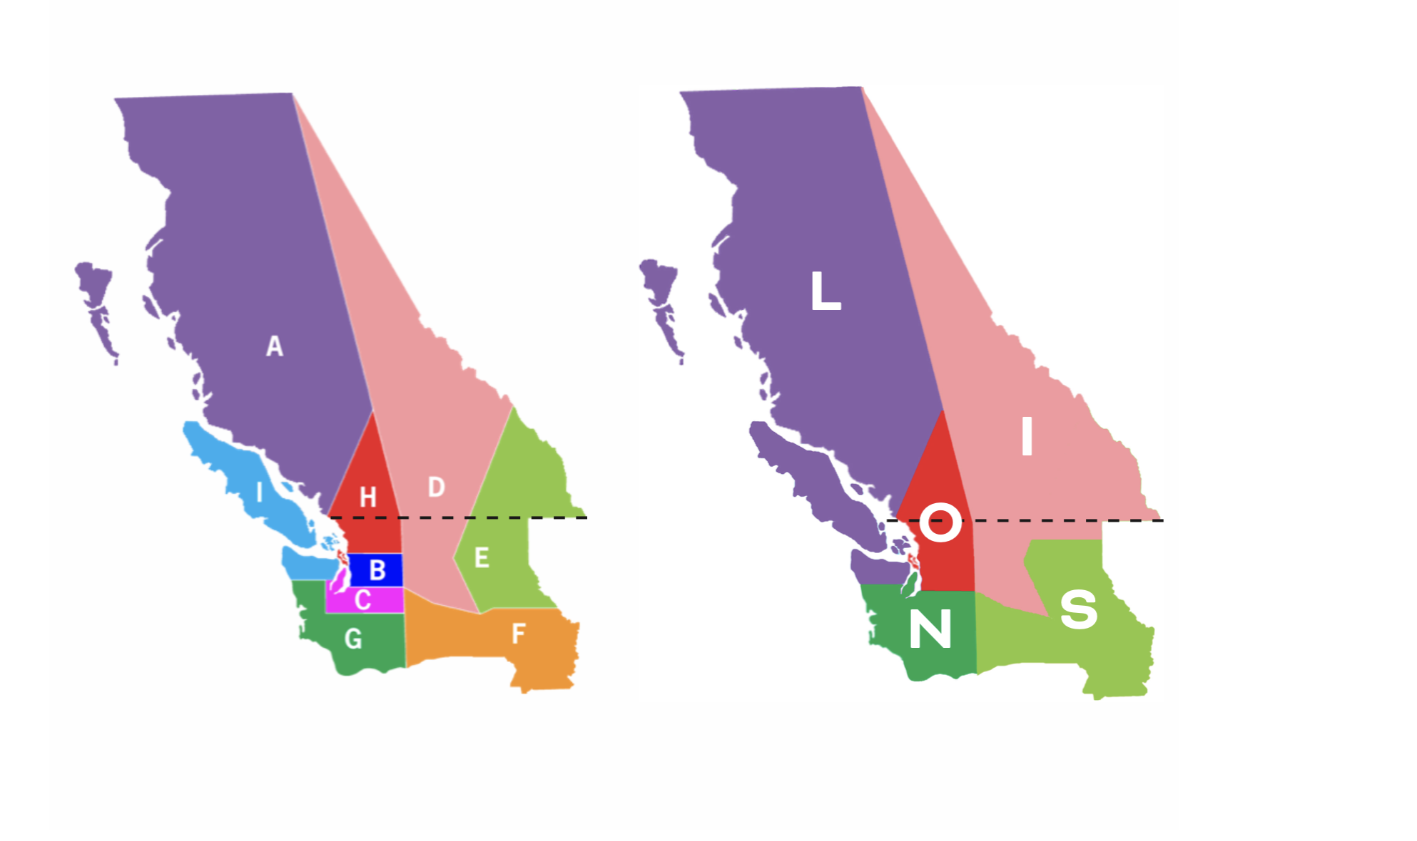
Old and New MD19 Maps

Slide 4
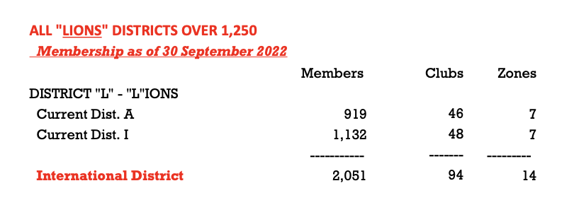
The Makeup of New Districts “LIONS”

Slide 5
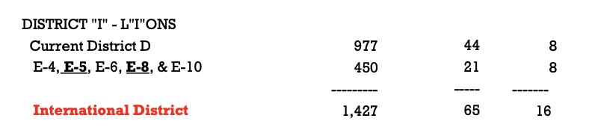
The Makeup of New Districts “LIONS”

Slide 6
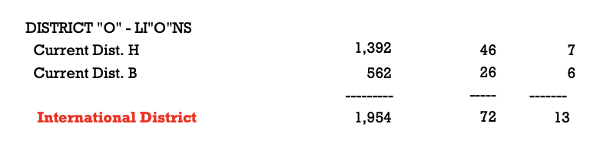
The Makeup of New Districts “LIONS”

Slide 7
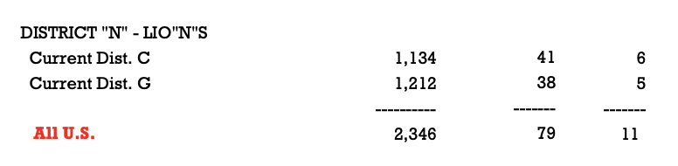
The Makeup of New Districts “LIONS”

Slide 8
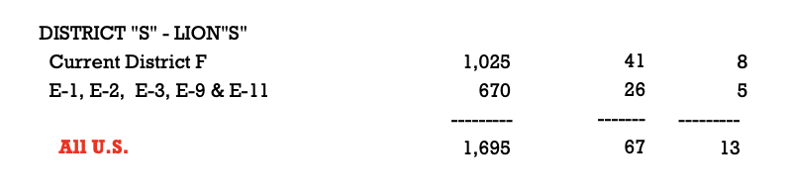
The Makeup of New Districts “LIONS”

Slide 9
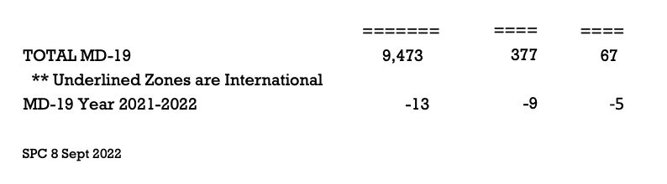
The Makeup of New Districts “LIONS”

Slide 10
In This Presentation
The Role of the District Merger Committees: Ten discussion points.
Elections - District Officers
District Budget and Finance
Other District Assets to Consider
District Constitution and Bylaws
District Leadership programs
District Membership Programs
District Service Programs
District Websites, Newsletters and Social Media
District or MD Representation
District Spring convention

Slide 11
Redistricting 101
The Role of the District Merger Committees
(1)First Up:
Election of District Officers
Notes:
Election of officers is the most pressing initial requirement and must be completed before JANUARY 1, 2023.

Slide 12
(1) Election of Officers
District Officer & Organization Board Policy Chapter IX,
Paragraph I (eye) section 7, page 15.
7. The election of the district governor, first vice district governor and second vice district governor must take place following the approval of the proposal by the International Board of Directors and prior to the International Convention for which the redistricting will follow.
Notes:
BOARD POLICY REQUITEMENTS FOR UPCOMING ELECTION.

Slide 13
(1) Election of Officers, Cont.
District Officer & Organization Board Policy Chapter IX,
Paragraph I (eye) section 7, page 15.
The election must take place during a properly called meeting of the delegates of the new district.
It is suggested that the election take place during an existing district or multiple district convention for which the delegates would normally attend.

Slide 14
(1) Election of Officers, Cont.
District Officer & Organization Board Policy Chapter IX,
Paragraph I (eye) section 7, page 15.
Redistricting proposals that are approved during the October or November board meeting that are scheduled to take place at the close of the International Convention of the same fiscal year must hold elections before January 1, to enable the district governor elect to attend the First Vice District Governor/District Governor Elect Seminar held in February
Notes:
THIS IS OUR PARTICULAR SITUATION, SO VOTING MUST TAKE PLACE RELATIVELY SOON.

Slide 15
(1) Election of Officers, Cont.
MD will set up and pay for electronic voting by Election Buddy
30 Day Notification Period Starting Oct 15. Election must take place after November 15.
Five Day Voting Window. Recommend November 28-December 2.
Eligible Clubs will select and certify delegates (1 per 10 members)
Secretaries will receive ballots and forward them to certified delegates
Club Delegates will vote in the five day window on the MD19 Website

Slide 16
(1) Election of Officers, Cont.
All District Officer Candidates will need to submit letter of intent to MD19 before the election. Candidates must also obtain their Club Endorsement.
Candidates for DG, 1VDG and 2VDG will be listed
Winning names will be forwarded to LCI. DG’s will attend LCI Training in February; VDG’s will commence online training.

Slide 17
(1) Election of Officers, Cont.
Create a Working Team
QUESTION:
What do you do when you now have a District that has 82 clubs? How do we recommend managing that?

Slide 18
Election of Officers
Create a Working Team
Divide the visitations into thirds. Make a visitation plan.
Consider using Zoom Meetings as necessary
Consider speaking at Zone meetings to reach Presidents and Secretaries.
Consider Region Chairs
Consider the “DG as CEO” Model
SET A POSITIVE WORKING EXAMPLE FOR FUTURE DG TEAMS THAT WILL STRESS DIVISION OF DUTIES

Slide 19
Redistricting 101
The Role of the District Merger Committees
(2) DISTRICT BUDGET AND FINANCE
District Checkbook Account/Savings
Merging of Escrow and Operations Accounts
Districts may hold monetary assets such as income from dues and should be allocated in a way that is fair. Some have split the the remaining funds by the number of members/clubs that would be in the new district or in a way that supports activities that will be used.
Consider Legacy Fundraising effort AND legacy Foundations

Slide 20
Redistricting 101
The Role of the District Merger Committees
(3) OTHER DISTRICT ASSETS TO CONSIDER
Equipment that is owned by the District
Space or Leases that are contracted by the District
District Foundations
Contracts that either district is bound by or party to any commitment or service provided by the district

Slide 21
Redistricting 101
The Role of the District Merger Committees
(4) DISTRICT CONSTITUTION AND BYLAWS
It is recommended that the district adopt a Standard Constitution and Bylaws (available in the Board Policy Manual online at LCI) and then determine what special carveouts may be needed for each district. Keep in mind the Standard Constitution and Bylaws will be the governing document until the amended Constitution and Bylaws is approved by the delegates of the new district. (EG, at the next district convention)

Slide 22
Redistricting 101
The Role of the District Merger Committees
(5) DISTRICT LEADERSHIP (GLT)
New Club officer training
Guiding Lion Training
Recognition Programs
Other legacy training from each district

Slide 23
Redistricting 101
The Role of the District Merger Committees
(6) DISTRICT MEMBERSHIP (GMT)
Recruiting, retention and new club formation programs
Zone Chair Recruiting and recognition
Lions Journey Program for new members
LEO Clubs
Virtual Clubs

Slide 24
Redistricting 101
The Role of the District Merger Committees
(7) DISTRICT SERVICE (GST)
Childhood Cancer Programs
Sight and Hearing Programs
Hunger
Diabetes
Environment
Other legacy Service Projects from each district

Slide 25
Redistricting 101
The Role of the District Merger Committees
(8) DISTRICT WEBSITES, NEWSLETTERS AND SOCIAL MEDIA
Combine these assets and plan additions / phase-in, phase out for websites and social media

Slide 26
Redistricting 101
The Role of the District Merger Committees
(9) DISTRICT OR MD REPRESENTATION
Position on Foundations (NW Lions Leadership, NW Lions Eyeglass Recycling Center, Camp Leo, Project New Hope, Camp Horizon, Camp Stix, MD19 Lions Foundation, NW Lions Foundation, CLERC, BC Society and all other Foundations
Positions on Multiple District or or area projects
Other positions within NGO’s or other organizations represented by a district.

Slide 27
Redistricting 101
The Role of the District Merger Committees
(10) DISTRICT SPRING CONVENTIONS
Budgets
Staffing
Location/Time

Slide 28
Redistricting 101
The Role of the District Merger Committees
In summary, the District Merger Committees are key to blending the new districts
Each District Governor Team should select a strong group to represent their District and every effort should be made to select individuals who are cooperative leaders and problem solvers

Slide 29
Redistricting 101
The Role of the District Merger Committees
In the recent words of MD19 Council Chair, Lyndon Harriman:
“It is time for us to look ahead, not focus on the past, but to plan for the future. We need to work together to make our Multiple District the very best it can be. That will take all of us working together. Each new district faces challenges unique to itself. We need to rely on the expertise of our fellow Lions to move into the future and make it as bright as we can. WE can do this, WE can work together.”

Slide 30
Redistricting 101
Questions and Answers
Questions and Answers

